Slide 1


Slide 2

FLIP FIT
Gym Management System
Group A

Slide 3
Framework for 5 days
Daily Discussions: Engage in daily discussions covering diverse topics and technologies.
Interactive Brainstorming: Take regular sessions with SME for collaborative problem solving.
Project Planning: Ensure alignment with project goals and milestones.
Hands-on Application: Encourage practical exercises for skill development.
Progress Assessments: Regularly assess and Adapt the plan based on feedback and challenges.

Slide 4
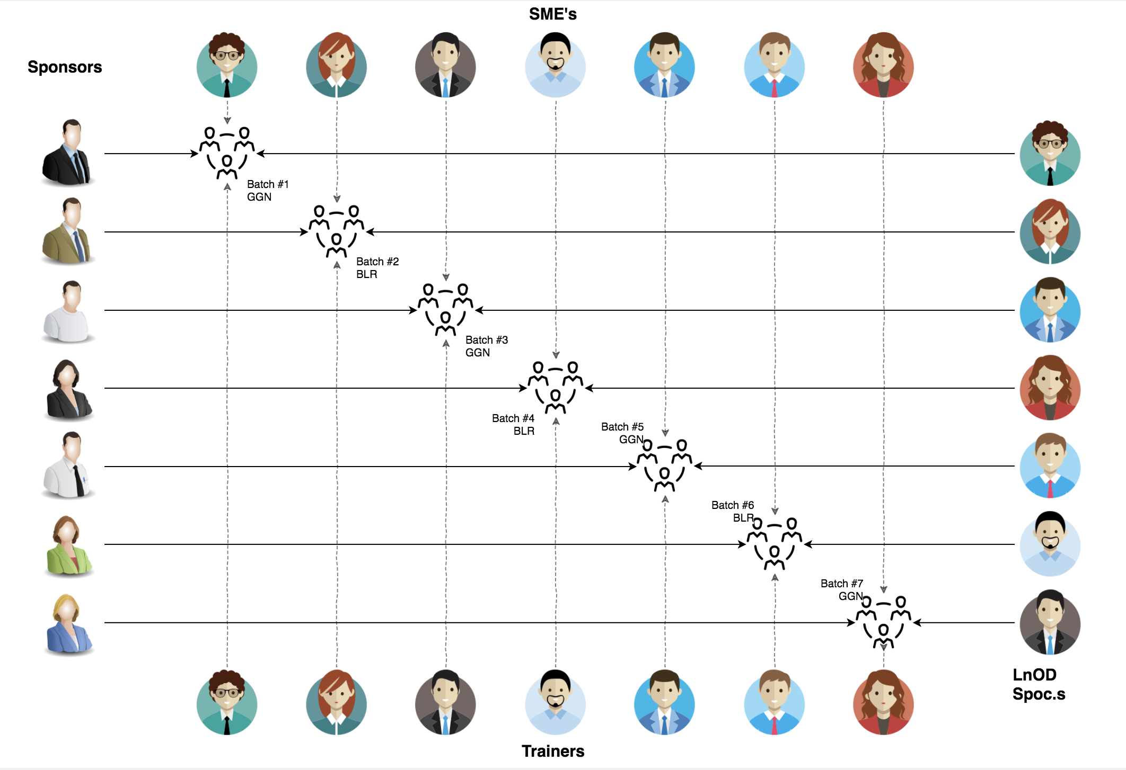
Stakeholders
Sponsors
Flipkart
SMEs
Amit Balyan
Trainers
Sharath Ramesha

Slide 5
1 Week Of Training
7 DAYS
168 HOURS
10,080 MINUTES
6,04,800 SECONDS
LIMITLESS KNOWLEDGE

Slide 6

Agenda
Our Journey
Our Team
Project Goals
Engineering Best Practices
TechStack
Development
Challenges and Learnings
Demo
Questions
‹#›

Slide 7
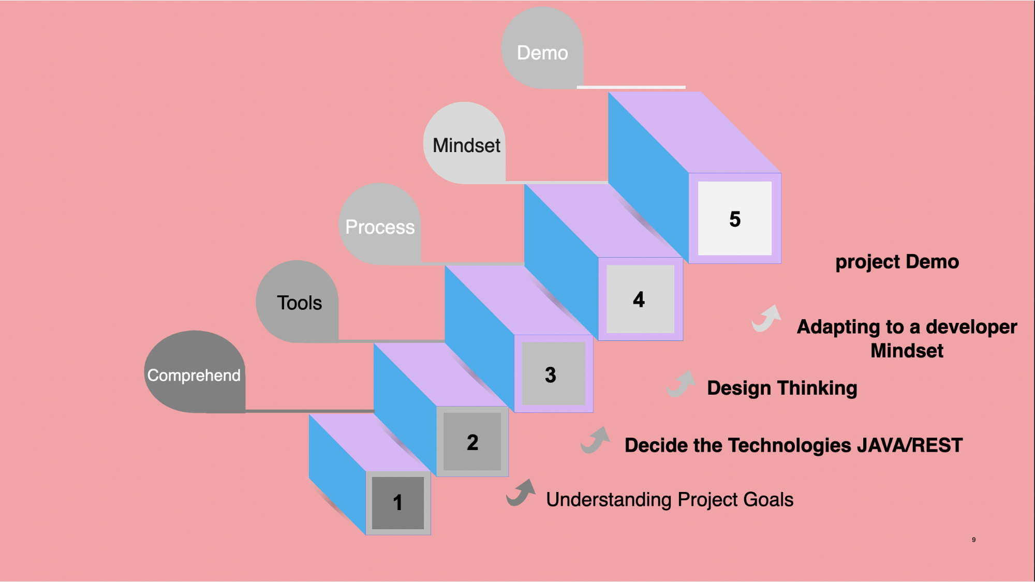
Our Journey

Slide 8
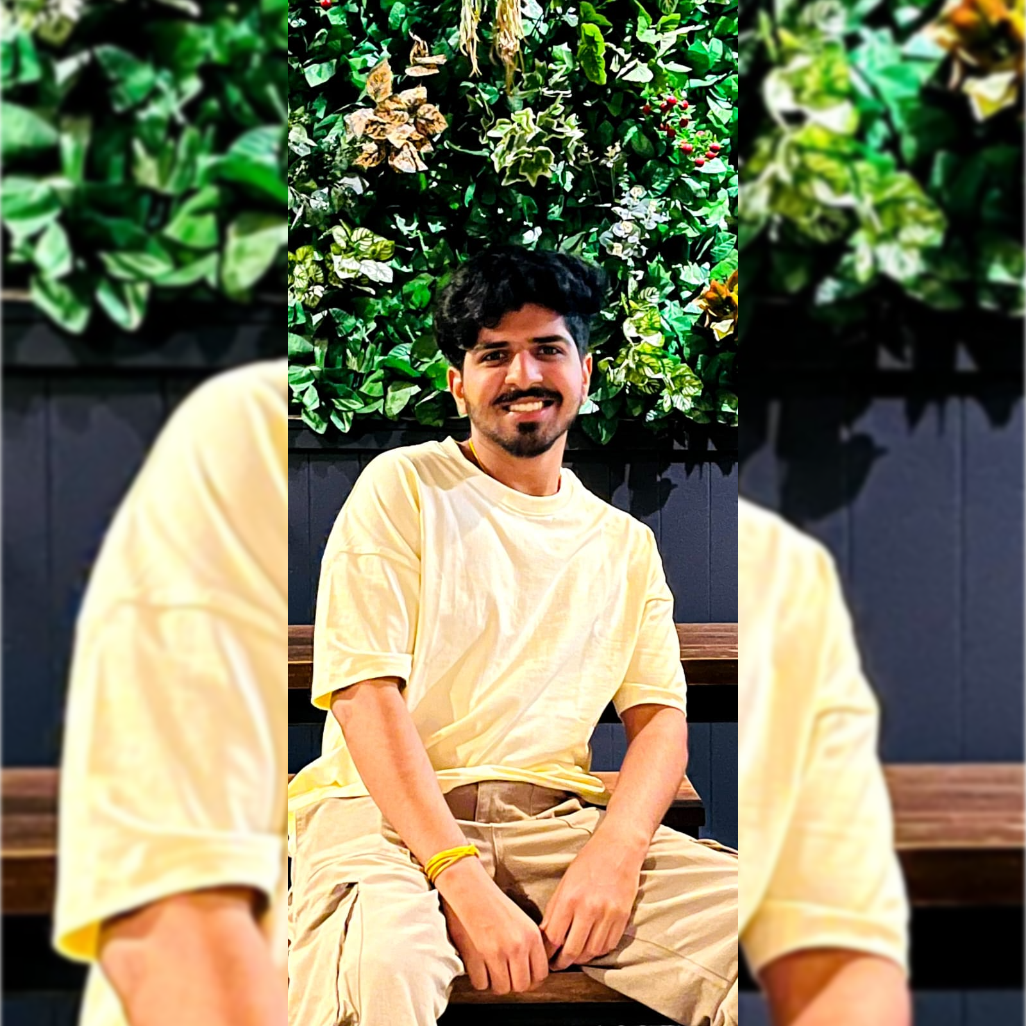

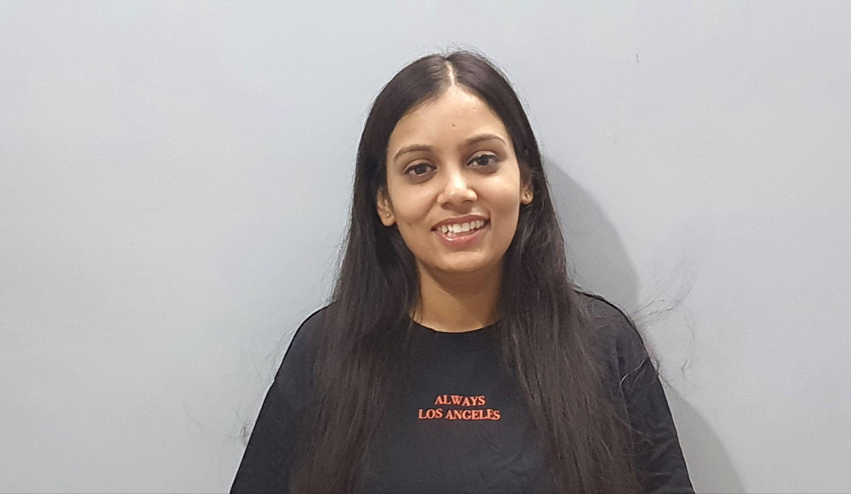
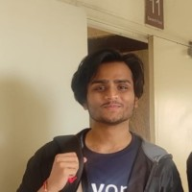
Our Team
Siddhanth Verma
Rahul Kumar
Achintya Nigam
Akansha Parihar

Slide 9

Project Goals

Slide 10




Our Vision
1
2
To design and implement FlipFit Application(Gym Management System) where user can view gym centres and slots available, book and cancel slots. Gym owner can register his gym and add slots for a particular gym, view bookings etc. Admin can approve register requests for gym owner, gyms and users.
Quality
Security
3
4
Interactivity
Speed

Slide 11
Engineering Best Practices
Modularization
Version Control
Code comments
Code Refactoring
Clean Code

Slide 12


Tech Stack and Tools

Slide 13






Backend
Data
Tools

Slide 14
Development Process
Requirement
Gathering and understanding
Research and analysis
Planning
Grooming
Delivery
Implemen-tation
LLD
Development
Code Review
Commit
Integrate
Deploy
Test

Slide 15

Challenges & Learnings
Java 8 features
Dropwizard
Git
JDBC Connection
Team collaboration
Tight Schedule

Slide 16

Demo

Slide 17



Questions?

Slide 18


